Slide 1
Department of Children & Youth
Child Match ICCA Integration Live Event
October 8, 2024

Slide 2
overview
This Build brings Ohio SACWIS ICCA Integration to Child Match
Ohio SACWIS Users will use the ICCA (Individual Child Care Agreement) to create Child Match Placement Need Posts
There is no need for these users to leave Ohio SACWIS to complete the process
Recommending Agencies will use Child Match as they did in the initial release
Community URL will still be active

Slide 3
Ohio sacwis changes
Need for Child Location Topic
Additional Question "Do you currently have a provider identified for this youth?"
Question added if the youth has siblings that need placed with them

Slide 4
Ohio sacwis changes
Sibling Linking/Unlinking
When you answer “Yes” to the siblings question all of their open ICCAs will populate in a dropdown or you can select “New” to create a new ICCA
This can be edited until the ICCA is “Placed” or “Canceled”
Cannot duplicate linking
Ex) Cannot link Sibling A to Sibling B’s ICCA 1 and Sibling B’s ICCA 2

Slide 5
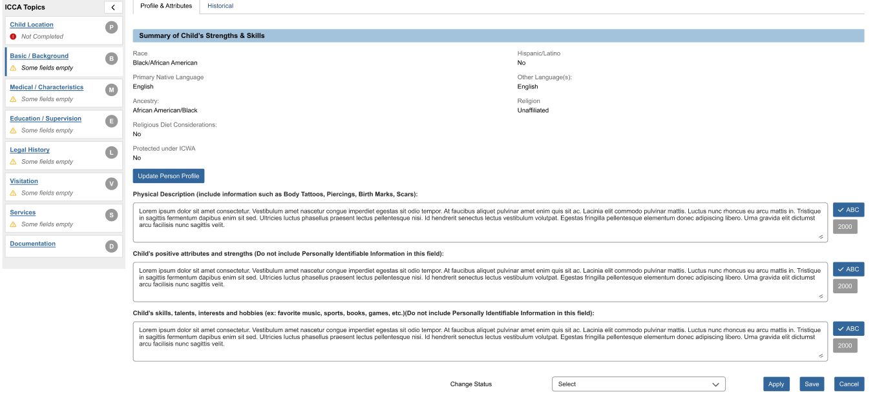
OHio SACWIS ICCA updates
Basic/Background ICCA Topic (Profile and Attributes Tab)
Updated question labels and added text to not include Personally Identifiable Information in questions that will be used in the Child Match Placement Need Post
Notes:
Will need to zoom in on the mockup during meeting

Slide 6
OHio SACWIS ICCA updates
Education/Supervision Topic
The "Educational Achievements" textbox has been renamed "Educational achievements including subjects and activities the child/youth enjoys in school"
Notes:
Will need to zoom in on the mockup during meeting

Slide 7
OHio SACWIS ICCA updates
Status Changes
Additional Statuses when using the Child Match Pathway
When a Provider is already identified
Notes:
Will need to zoom in on the mockup during meeting

Slide 8
OHio SACWIS ICCA updates
Placement/Child Location Topic
New Potential Matches Tab
Will only show if Child Match was utilized
Uses functionality from current "Placement Request" topic in Ohio SACWIS
Acceptance of a Provider on this screen will automatically reject all other providers and mark ICCA as “Placed”

Slide 9
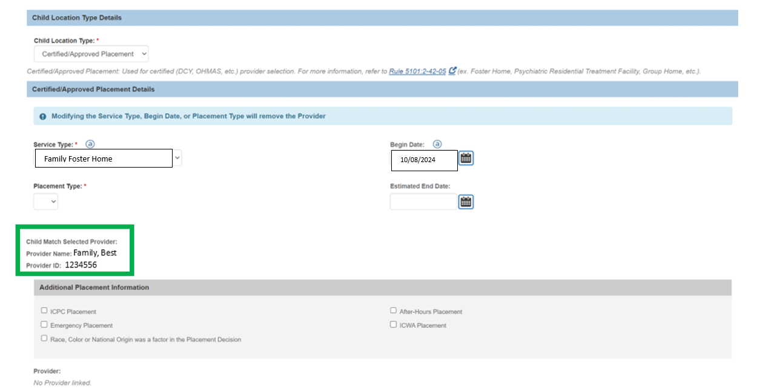
OHio SACWIS ICCA updates
Draft Placements created for accepted provider
Provider will not be linked, but will show on the screen for easier access when completing the Child Location record

Slide 10
OHio SACWIS ICCA updates
Action Item when a Recommending Agency Indicates Interest
Will be sent to the Case ID where the ICCA was created
Will take the user to the ICCA List View
<Recommending Agency E-Mail Address> needs information for <Youth's Person ID> <ICCA ID>
OR
<Recommending Agency E-Mail Address> has Updated Provider(s) for <Youth's Person ID> <ICCA ID>

Slide 11
Requesting Agency Child match Overview
There have been no changes to the Community URL in this Build
You can access the Live Event for this Functionality here:
https://jfskb.com/sacwis/index.php/child-match

Slide 12
Recommending Agency Child match Overview
There have been some label changes to match fields coming from the Ohio SACWIS ICCA
Changes to Indicating Interest
Messaging is still active, but will only go to Requesting Agencies not utilizing Ohio SACWIS
No changes to notifications
See the Live Event for the full Recommending Agency Functionality here:
https://jfskb.com/sacwis/index.php/child-match

Slide 13
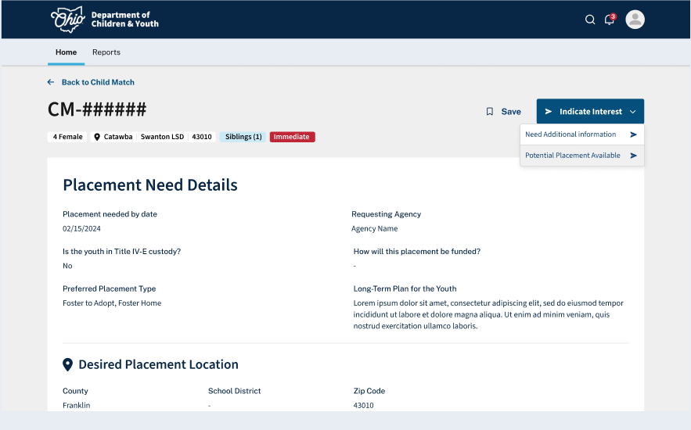
Notes:
From the Placement Need Post, you are able to Indicate Interest. You can do this by requesting additional information or by giving a potential placement provider. If you click need additional information, that will be sent to the user that created the post and nothing additional is needed from you.

Slide 14
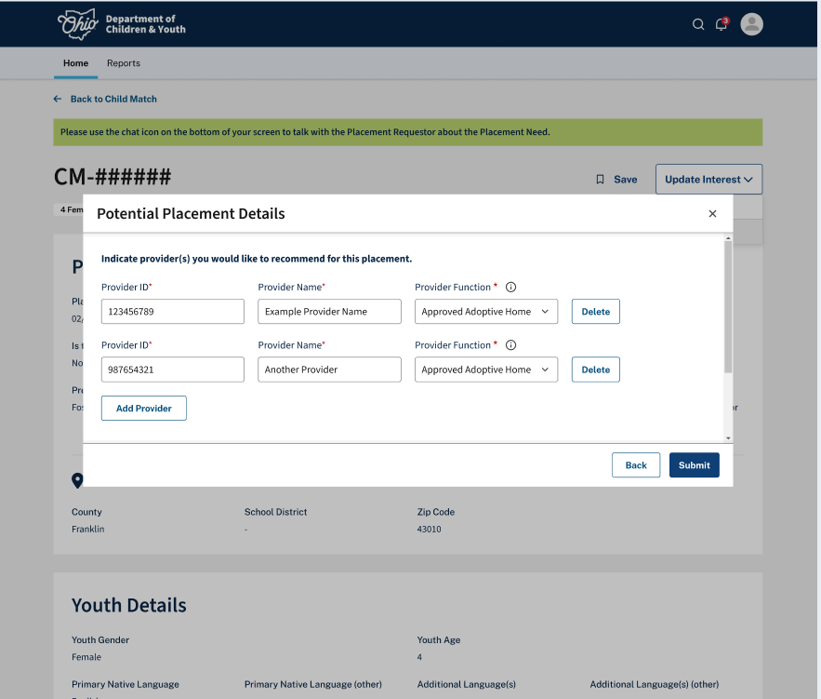
Notes:
If you click Potential Placement available, you will be asked to enter the Provider ID, Provider name, and Provider Function for each potential placement you have. This doesn't mean that provider will 100% take that youth, but that additional conversations should be had to confirm that this would be a good fit. You can enter one or 100 providers.

Slide 15
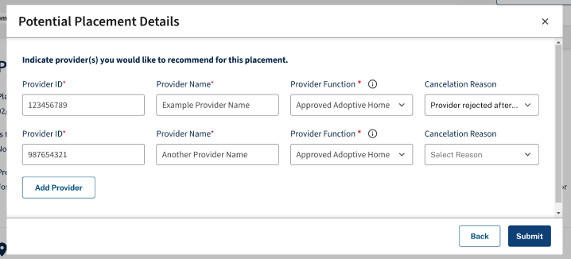
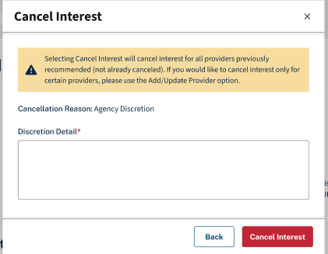
Notes:
From this page you can also Add or Update your providers, cancel your interest on one or multiple providers, or cancel your overall interest. You will be asked for a cancellation reason either way. If canceling overall interest, you will be provided a textbox to state why interest was canceled. If canceling individual providers, you will be asked to select a cancellation reason from the drop down list. You can also add another provider line if you have an additional provider that may be interested in placement.

Slide 16
Questions

